Slide 1

AI아카데미
임베디드AI
with Rapsberry Pi
2022. 05.
황유민
yumin@etri.re.kr
에너지지능화연구실

Slide 2
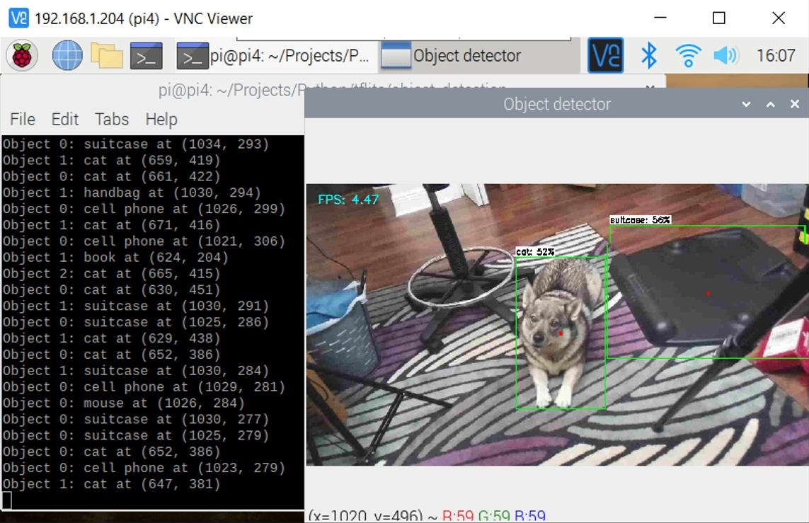
Goal
Object Detection with RapsberryPi

Slide 3
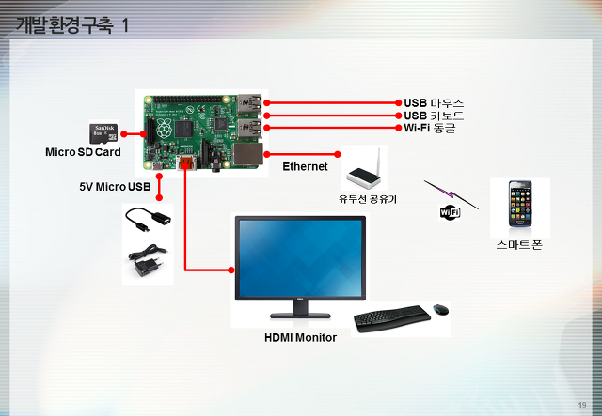
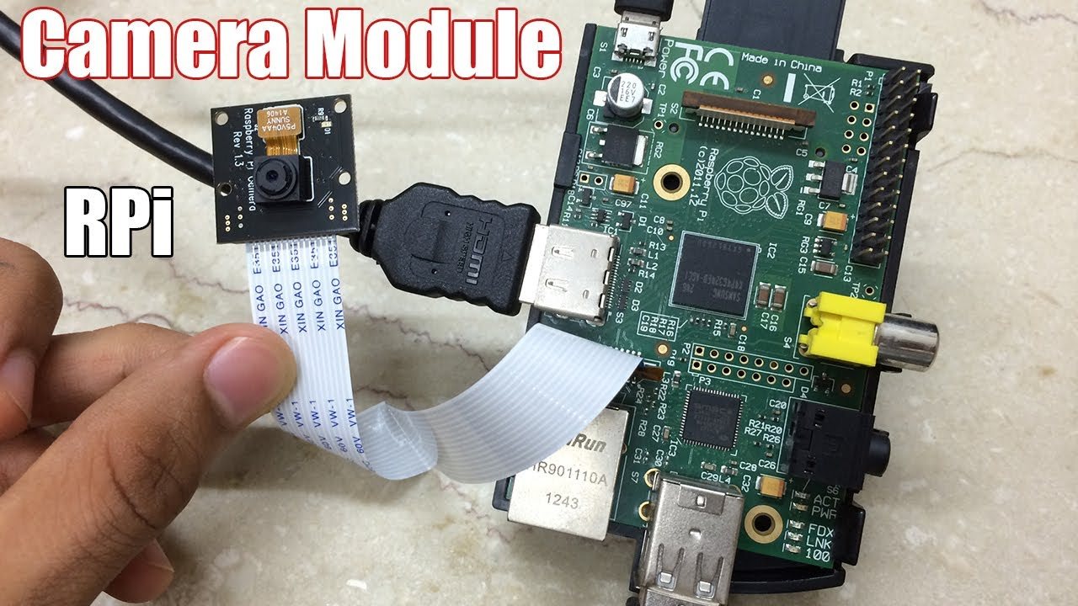
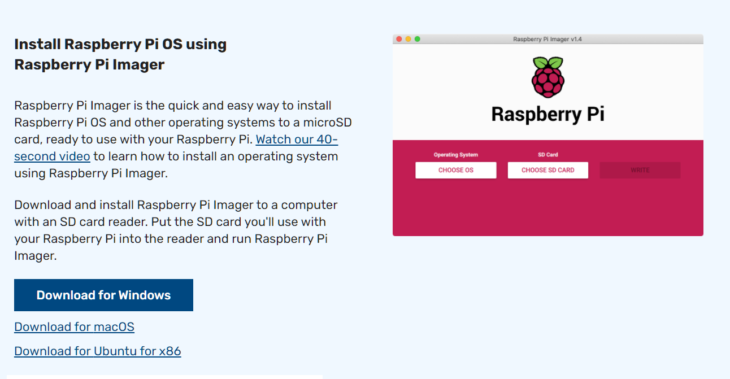
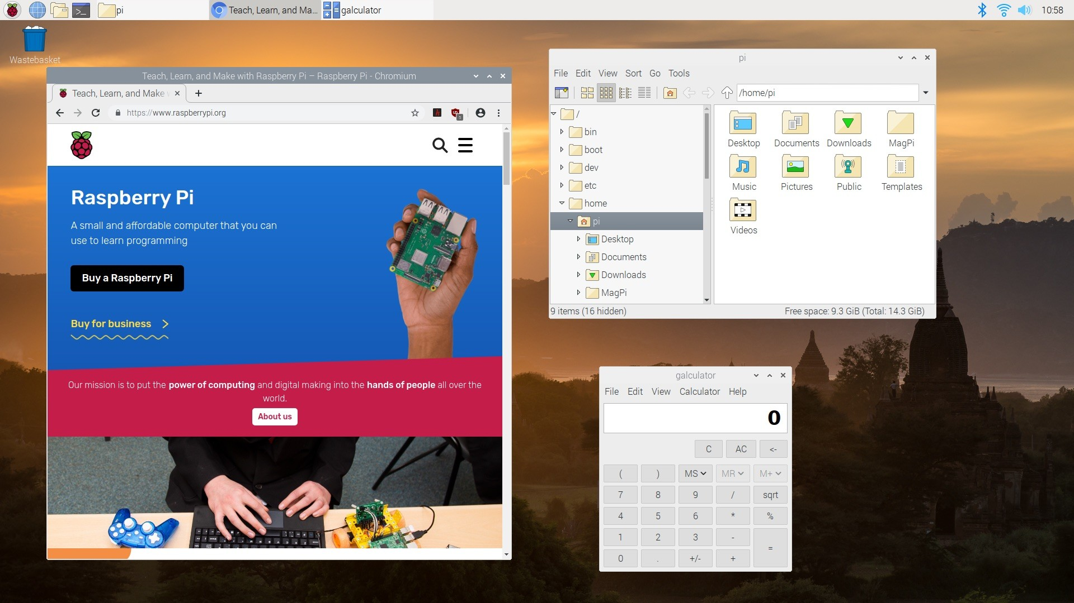
RapsberryPi Install & Setting

Slide 4
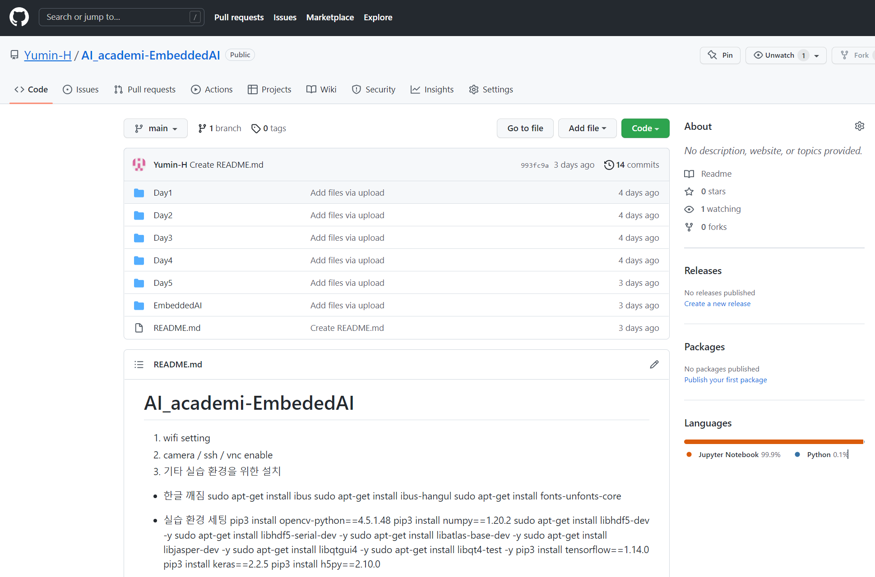
Install Guide & Code
Github.com/yumin-h/AI_academi-EmbeddedAI

Slide 5
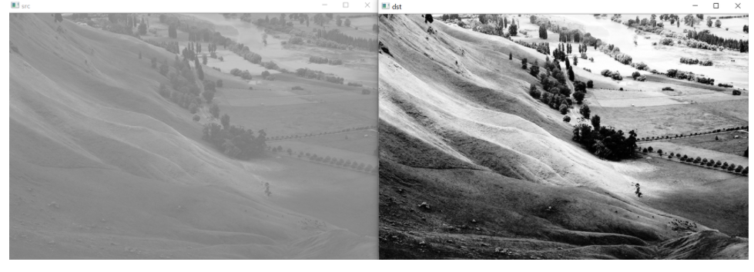
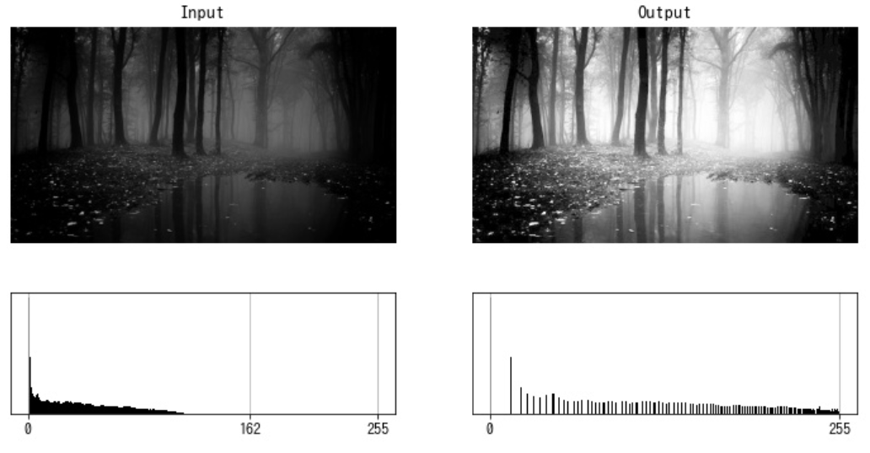
Preprocessing
영상 히스토그램 평활화 - cv2.equlizeHist
OpenCV에서 제공하는 cv2.equlizeHist 함수

Slide 6
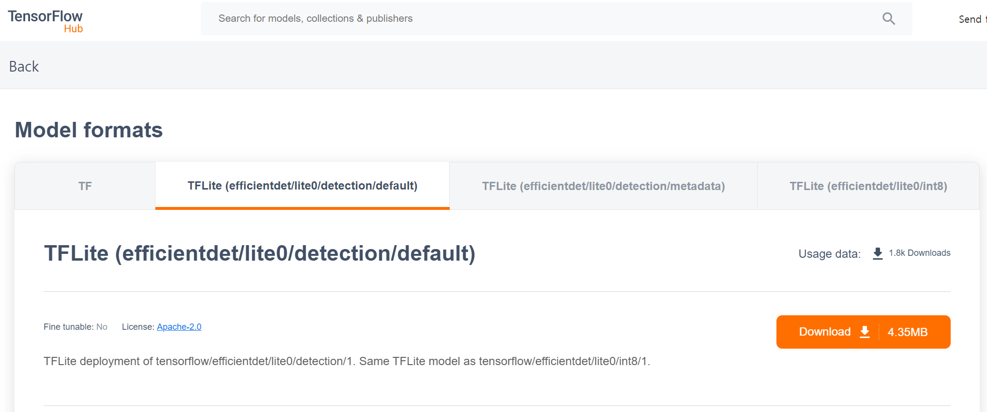
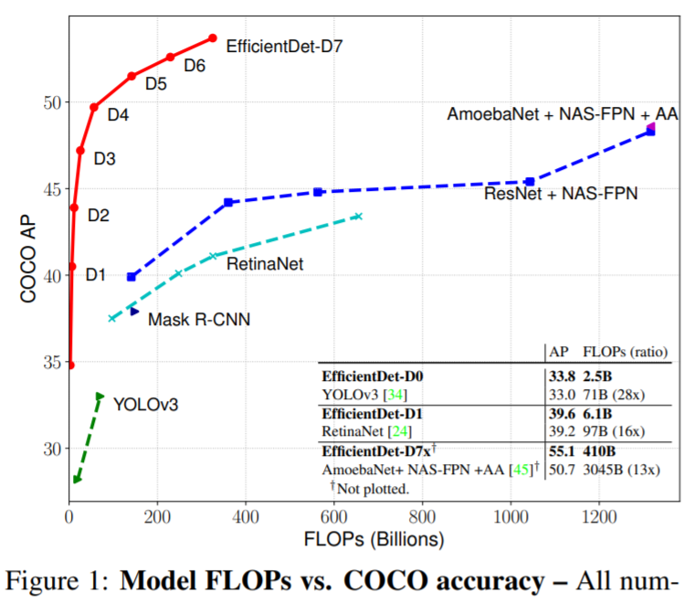

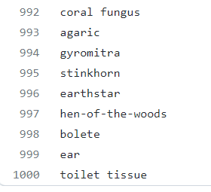
TFLite
TensorFlow Hub (tfhub.dev)
M. Tan, R. Pang and Q. V. Le, "EfficientDet: Scalable and efficient object detection" in arXiv:1911.09070, 2019, [online] Available: http://arxiv.org/abs/1911.09070.

Slide 7
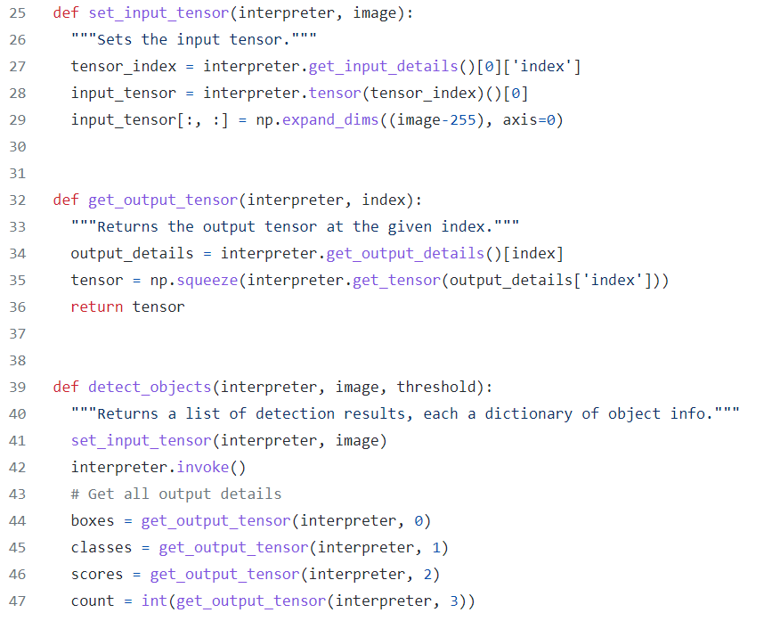
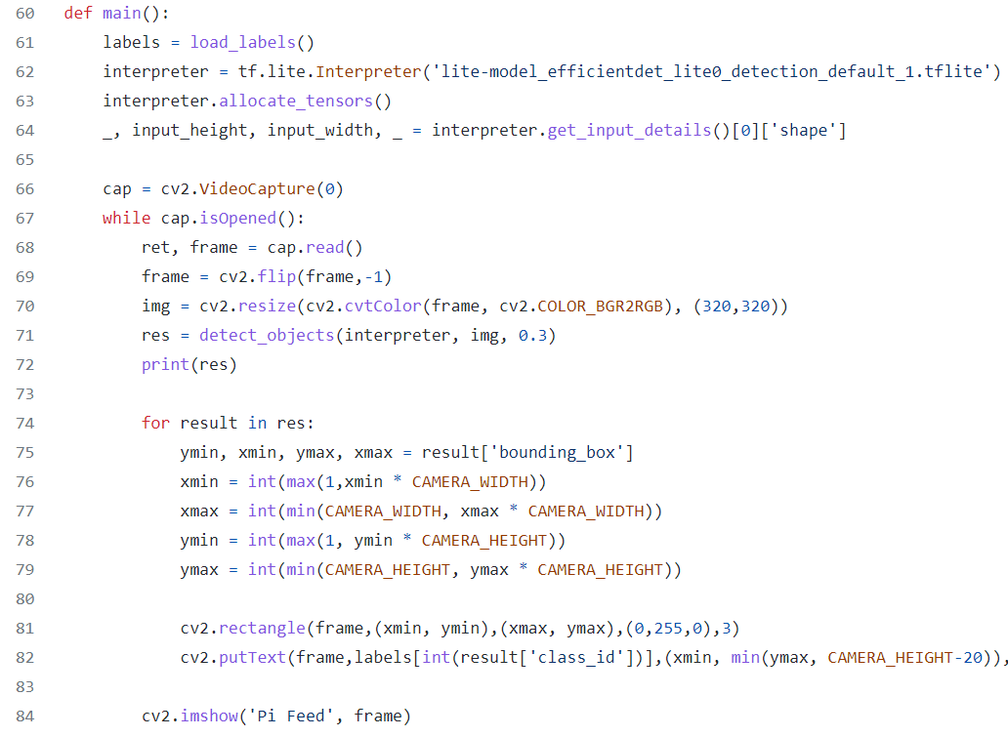
tf.lite.Interpreter

Slide 8
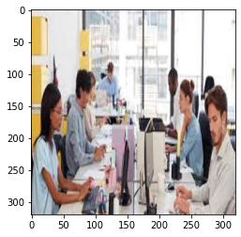
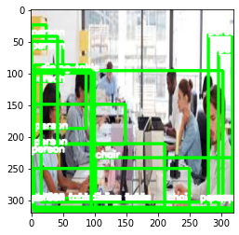
Multiple Object Detection
Efficientdet (1,000 class)

Slide 9
감사합니다.
Q & A

